Slide 1

Bangladesh Army University of Engineering & Technology (BAUET)
Qadirabad, Natore-6431
Department of Computer Science and Engineering
Course Code: CSE-3104
Course Title: Software Engineering and Information System Design Sessional
Project Presentation on “BAUET Result System”
Submitted by:
ID: 20104001, 20104007,
20104009, 20104027,
20104031, 20104033
Batch: 11th
Year: 3rd
Semester: 1st
Session: 2020-2021
Submitted to:
Md. Nazmus Salehin
Lecturer, Dept. of CSE, BAUET
Mst. Irin Sultana
Lecturer, Dept. of CSE, BAUET

Slide 2







Team Members
Name: Fahmida Rahman Moumi
ID: 20104001
Name: Md. Tanvir Ahmed Tagim
ID: 20104007
Name: Amrin Nahar
ID: 20104009
Name: Gourob Roy
ID: 20104027
Name: Mst. Bilkis Khatun
ID: 20104031
Name: Md. Arik Rayhan
ID: 20104033

Slide 3

Introduction
Motivations
Objectives
Features of the project
Tools and Resources
Methodology
Project Flowchart
Use Case Diagram
Project Layout
SWOT Analysis
Conclusion
Contents
1/15

Slide 4

What is BAUET Result System?
BAUET result system is a website where the result of the students will be published online using Database.
Introduction
2/15

Slide 5

Why do we need BAUET Result System?
The traditional result of BAUET works by manually creating the result of each student.
The process is that teacher take marks of each student based on OBE curriculum and then manually calculate the results of each student. Then their result is stored in a spreadsheet and given to the account office.
From this we can see that the system requires much human resource. So we plan to develop this project as using this we will reduce the need of human resource and save a lot of time.
Also, it will be saved in a database so the data can be better used for other system.
Motivations
3/15

Slide 6

Integration of all records of Exam.
Manage the information of result.
Manage the information of course.
Monitoring the information and transactions of course.
Searching facilities based on ID and Course Code.
Keep record of the students.
Minimize the manual paper work.
Objectives
4/15

Slide 7

Login system for both students and Teachers.
Create new Department.
Create new Courses.
Assign Course to Department.
Assign Teacher to Course.
Add Mark distribution for a particular Course.
Enrol students to Course
Show Students GPA and Marksheet.
Assign PO and CO to course.
Show CGPA of Students.
Features
5/15

Slide 8

Frontend
HTML
CSS
JavaScript
Bootstrap
Backend
JavaScript
PHP
Database
MySQL
Tools and Resources
6/15

Slide 9

Step 1: At first User have to enter the website.
Step 2: Then user have to login.
Step 3: Then the system will check if the user is
Teacher or Student
Step 4: The teacher will be able to modify marks
and subject and profile
Step 5: The user will be able to view result and
modify profile
Step 6: Then they will exit
Methodology
7/15

Slide 10
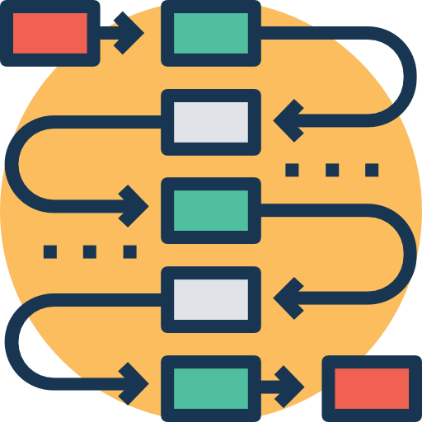
Start
Student
Manage Account
Login
Yes
No
View Result
Flowchart
Notice
Stop
Fig-01: Student Flowchart Diagram
8/15

Slide 11
Start
ADD Student
Admin
Manage Account
My Account
Login
Yes
No
Add Mark
Add PO, CO
Add Course
Add Credit
Stop
Fig-02: Admin Flowchart Diagram
9/15

Slide 12

Modify Profile
Drop Courses
<<Extend>>
Register Courses
Student
Generate/Print Transcript
<<Include>>
<<Include>>
Login
Record Test/Exams scores
<<Include>>
Generate/Print Master sheet
<<Include>>
<<Include>>
Manage Semesters/
Sessions
Use Case Diagram
Manage Courses
Teacher
View/Print Result
<<Include>>
Generate Registration Code
<<Include>>
Login
Add User
Admin
Fig-03: Use Case Diagram on Result System
10/15

Slide 13
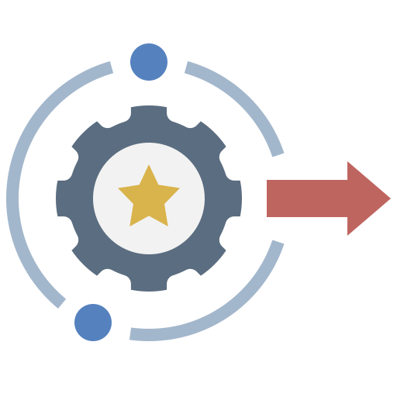
Student Section
Sign In
Search
Result
Report Card
Profile
Project Layouts
Administrator Section
Add Students
Add Teachers
Manage Courses
Manage Department
Modify
11/15

Slide 14




As it is a new system it can be difficult for some users to the transition opportunities
It will be faster than the traditional system and will save time
It will save Human Resources and Labour
Strength
SWOT
Analysis
Weakness
Opportunity
Minor Technical Glitches In The System
The data can be used on other systems as well
We can also integrate the payment system into the system
Threat
12/15

Slide 15

BAUET Result System is an online website and can be used at any place, any time and by any student or faculty. This application will avoid the calculation and simplify the process of visualizing results by students as well as faculty. The main objective was to enhance and automate the management and declaration of student’s results using a computerized system. A well-defined, efficient, controlled and managed information system or software based on web technology storing, processing and providing information through the internet.
Conclusion
13/15

Slide 16

14/15

Slide 17

Any Question?
15/15

